Slide 1
IBM University Engagement Project Submission
“Exploring the Power of Agentic AI with IBM Cloud and Orchestrate”

Slide 2

Project Tile –: AI-Powered Intelligent Shopping Agent
Domain of Project – Artificial Intelligence (AI) for E-Commerce, Smart Retail, and Recommendation Systems.
Student Name | Recent Passport Photo | Email ID | Mobile number [WhatsApp]
Samarth Jadhav |  | samarthjadhav9231@gmail.com | 7038244562

Slide 3
Problem Statement -
Proposed Solution: AI-Powered Intelligent Shopping Agent
Develop a multi-agent AI system using LangFlow, IBM watsonx.ai, and Granite Models to provide personalized shopping recommendations and intelligent purchasing assistance.
Use a RAG (Retrieval-Augmented Generation) pipeline to retrieve accurate product information, reviews, specifications, and pricing from trusted sources.
Implement a Product Discovery Agent to recommend products based on user preferences, budget, and shopping history.
Build a Price Comparison Agent to compare prices across multiple e-commerce platforms and identify the best deals.
Integrate a Review & Sentiment Analysis Agent to summarize customer reviews and highlight product strengths and weaknesses
.
Include a Personalized Recommendation Agent to generate tailored product suggestions using user behavior and preferences.
Develop a Streamlit or React dashboard to display product recommendations, price comparisons, review summaries, and shopping insights.
Use LangFlow for agent orchestration, IBM watsonx.ai for AI deployment, and Granite Models for reasoning, summarization, and personalized recommendations.
Continuously update recommendations using real-time product availability, pricing, discounts, and customer reviews.
Deliver an intelligent shopping assistant that saves time, reduces costs, and enhances the online shopping experience.

Slide 4
Proposed Solution -
Proposed Solution: AI-Powered Intelligent Shopping Agent
Develop a multi-agent AI system using LangFlow, IBM watsonx.ai, and Granite Models to provide personalized shopping recommendations and intelligent purchasing assistance.
Use a RAG (Retrieval-Augmented Generation) pipeline to retrieve accurate product information, reviews, specifications, and pricing from trusted sources.
Implement a Product Discovery Agent to recommend products based on user preferences, budget, and shopping history.
Build a Price Comparison Agent to compare prices across multiple e-commerce platforms and identify the best deals.
Integrate a Review & Sentiment Analysis Agent to summarize customer reviews and highlight product strengths and weaknesses
.
Include a Personalized Recommendation Agent to generate tailored product suggestions using user behavior and preferences.
Develop a Streamlit or React dashboard to display product recommendations, price comparisons, review summaries, and shopping insights.
Use LangFlow for agent orchestration, IBM watsonx.ai for AI deployment, and Granite Models for reasoning, summarization, and personalized recommendations.

Slide 5
Technology Used
IBM watsonx.ai – AI model deployment and inference
IBM Granite Models – Intelligent reasoning and recommendations
LangFlow – Multi-agent workflow orchestration
IBM bob

Slide 6
Component Used -
Components Used
1. Chat Input
Allows users to enter product requirements, preferences, budget, or shopping queries.
2. IBM watsonx AI Agent
Processes user queries using Granite Models to provide intelligent shopping recommendations, price comparisons, and product insights.
3. IBM Granite Model
Granite-4.0-8B-Instruct – Fast and efficient for product recommendation, reasoning, and review summarization.
4. Chat Output
Displays personalized product recommendations, price comparisons, review summaries, and buying suggestions.
5. File Component
The File Component stores product catalogs, specifications, shopping guides, brand information, and frequently asked questions. This data is processed through the RAG pipeline, enabling the AI agent to retrieve accurate product information and provide context-aware shopping recommendations.

Slide 7
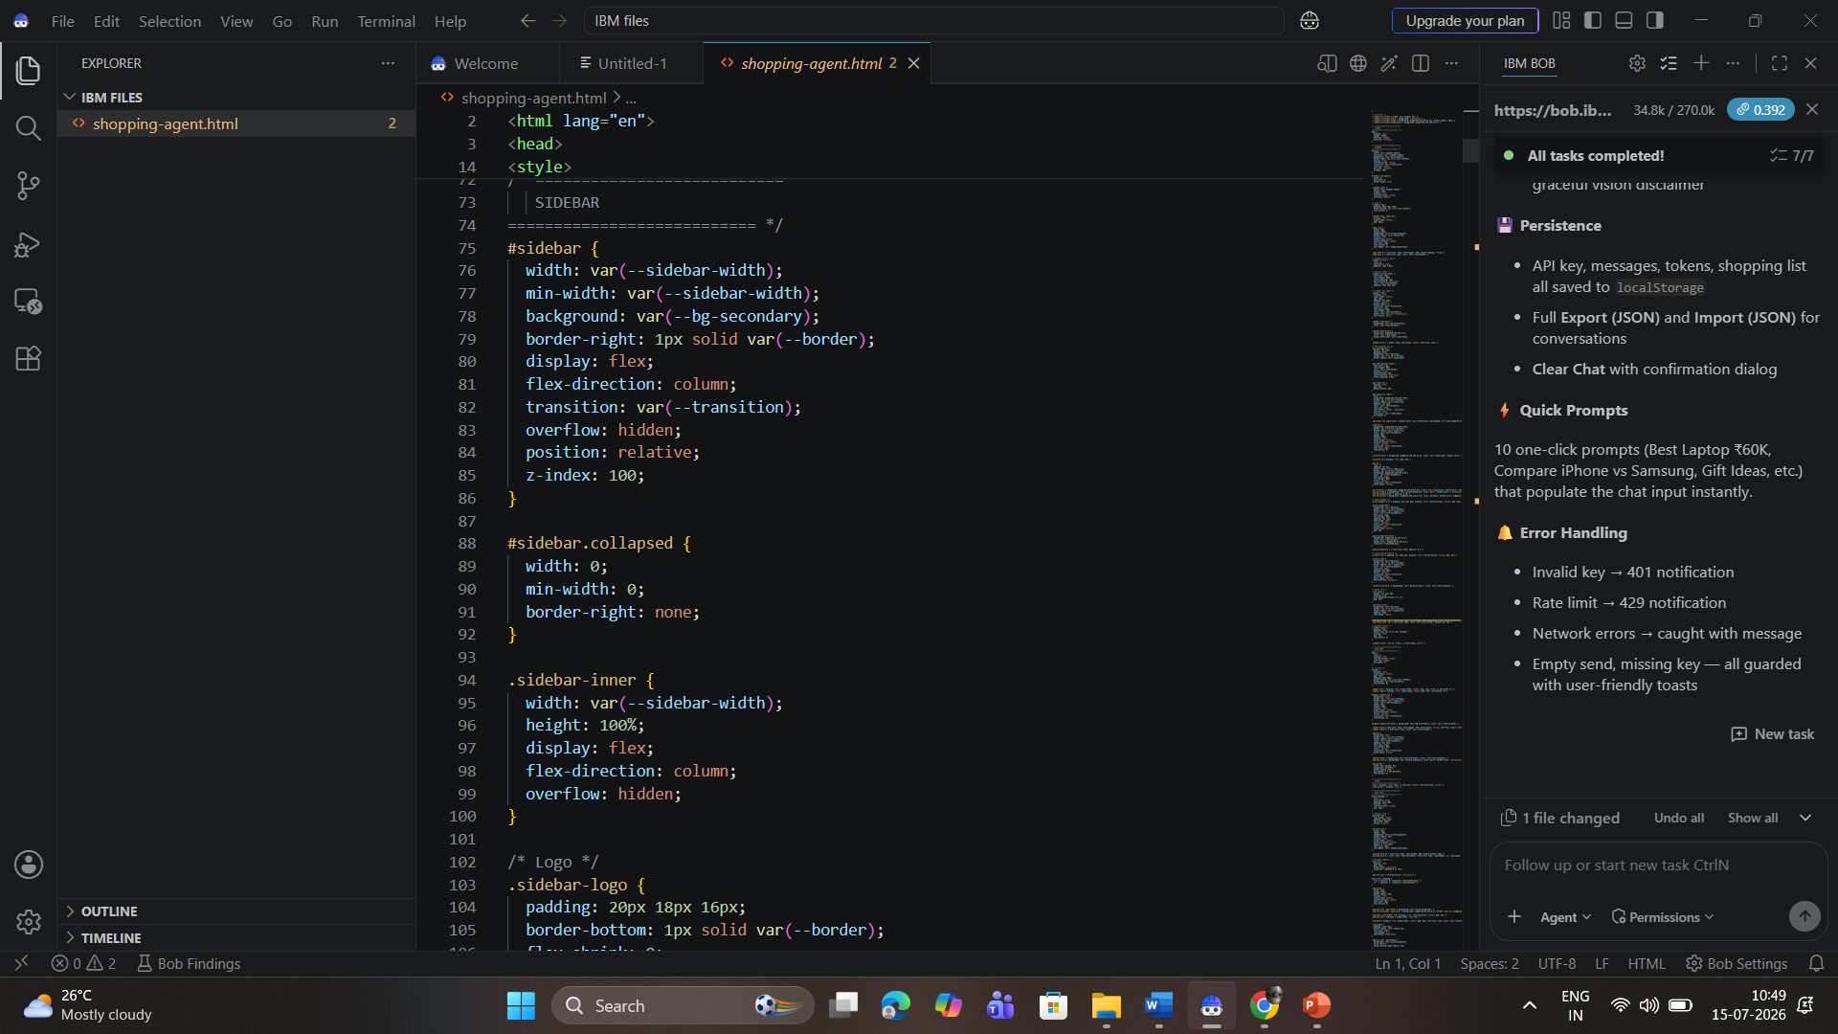
Agent Instructions Screenshot-

Slide 8
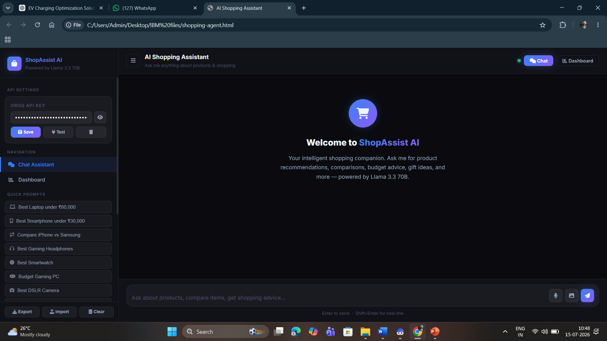

Slide 9
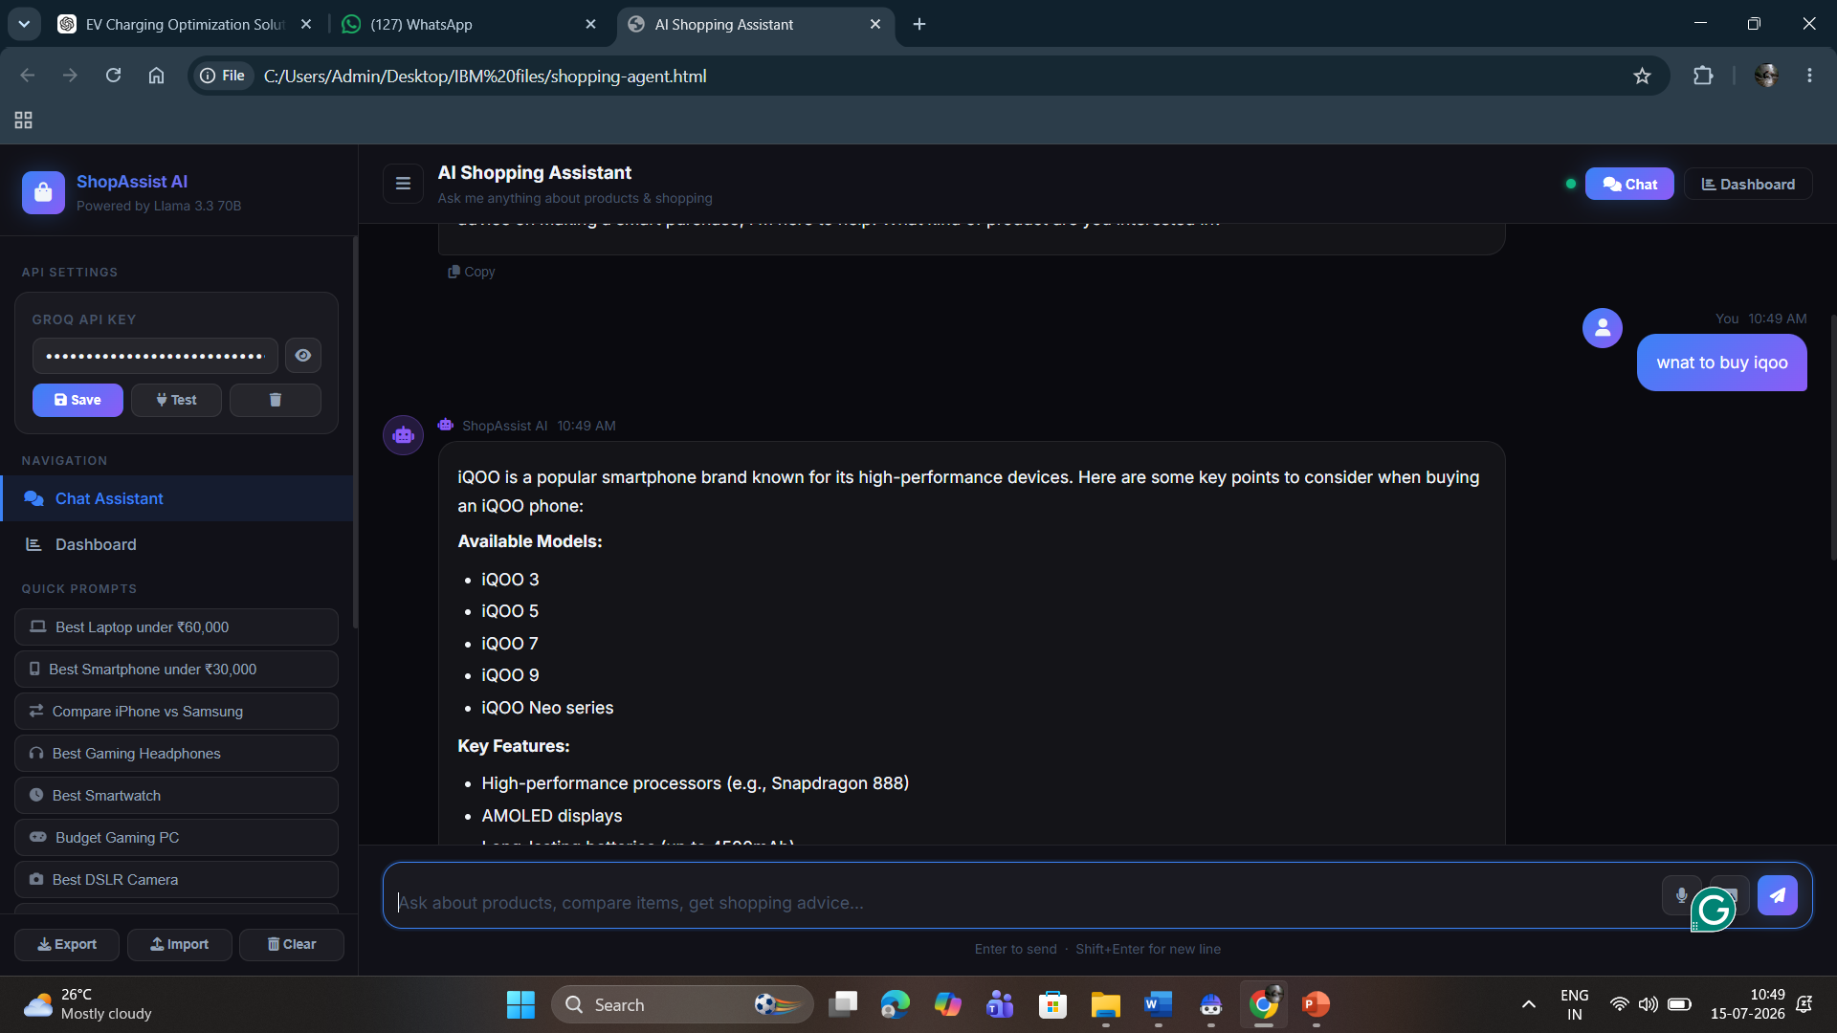

Slide 10
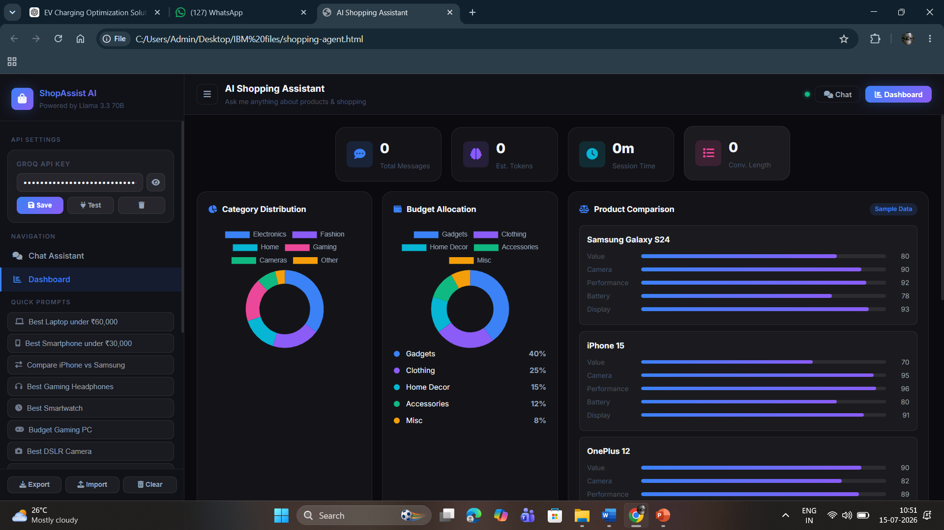

Slide 11

Role of Agentic AI in the solution
Role of Agentic AI in Intelligent Shopping Agent
Agentic AI serves as the decision-making core of the Intelligent Shopping Agent by autonomously analyzing user preferences, product information, pricing, customer reviews, and market trends. Multiple AI agents collaborate to discover suitable products, compare prices, summarize reviews, and generate personalized recommendations. The system continuously adapts to changes in product availability, discounts, and user preferences, providing intelligent, real-time shopping assistance that helps users make faster and more informed purchasing decisions.

Slide 12
Novelty and Uniqueness
The Intelligent Shopping Agent goes beyond traditional recommendation systems by using Agentic AI to autonomously discover products, compare prices across platforms, analyze customer sentiment, and generate personalized recommendations in real time. Unlike conventional shopping assistants, it combines RAG, multi-agent collaboration, and IBM Granite Models to provide context-aware, explainable, and adaptive shopping guidance based on user preferences, budget, and live market information.

Slide 13
Future Scope
Integrate voice-based shopping assistants.
Support AR/VR product visualization.
Add AI-powered negotiation and coupon optimization.
Predict future price drops using machine learning.
Integrate with multiple global e-commerce platforms.
Enable one-click purchasing through secure payment gateways.
Support multilingual shopping assistance.
Expand to B2B procurement and enterprise purchasing.
·
·
·

Slide 14
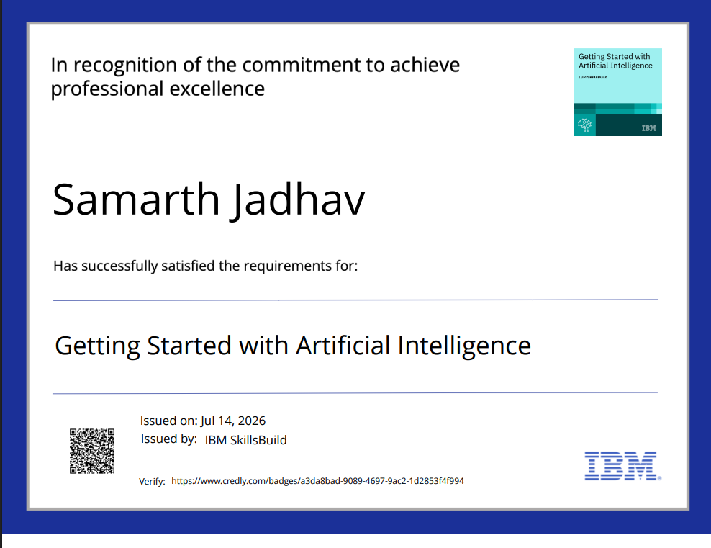
Certificates Earned:

Slide 15

Certificates Earned:

Slide 16
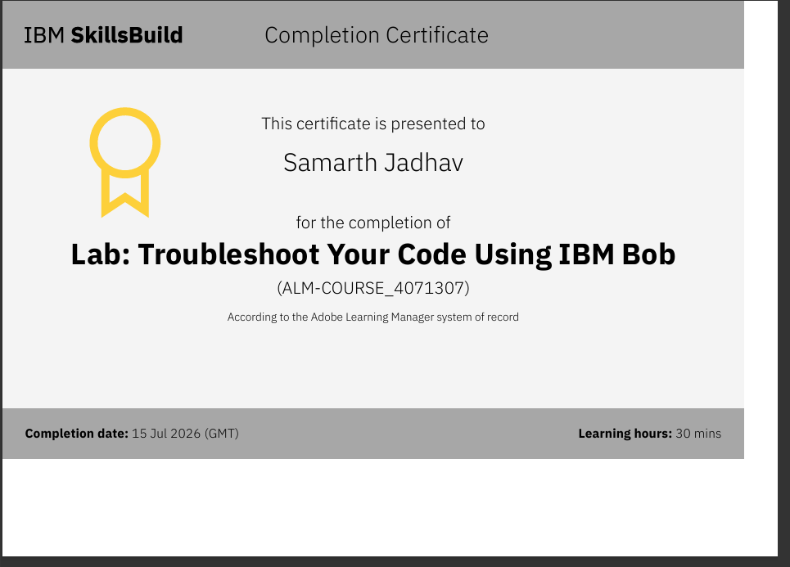
Certificates Earned:​

Slide 17
Git Hub Link
Please test and Paste the working Git hub URL – https://github.com/Anonymous-Samya/Shopping-intelligent.git
·
·
·

Slide 18


